Slide 1
Small Area Estimation of Poverty in Brazil and Mexico
Methodology comparison
March, 2024

Slide 2
This presentation…
How are the performances of ELL versus EBP unit-level models?
  What models are we comparing?
  How do the results compare?
How much does using only contextual variables matter?
  ELL unit-level vs. ELL context-level model.
  EBP unit-level vs. EBP context-level model.
  ELL context-level vs. EBP context-level model.
How do the performances of context-level models versus area and subarea-level models compare?
  Context-level models vs. Fay Harriot (FH) models.
  Context-level models vs. Boosted Regression Forest (BRF) models.
How do the performances of area-level models versus subarea-level models compare?
  FH vs. BRF.
What is the overall comparison across all models?

Slide 3
1. What models are we comparing?
 | EBP | ELL
Area effect conditioned on sample data | Yes | No
Weights rescale | Yes | Yes
Betas are fixed | Yes | Yes
“Alpha model” for heteroscedasticity correction | No | No
Area effect and idiosyncratic error term | Assumed normal | Non-parametric
Point estimates | Obtained through Monte-Carlo simulations (100) | Obtained through Monte-Carlo simulations (100)

Slide 4
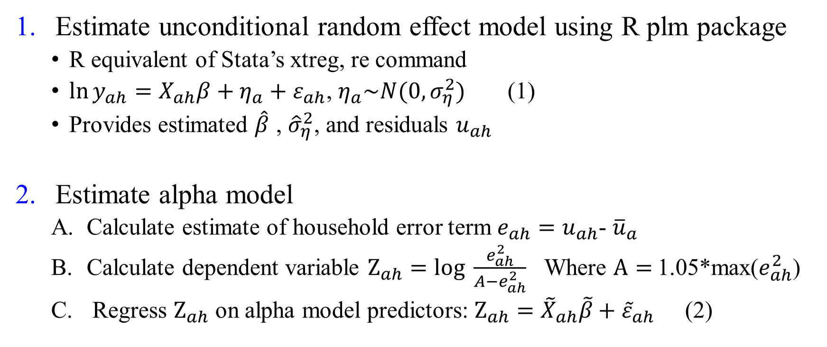
1. What models are we comparing?
ELL estimation process
Estimate unconditional random effect model using R plm package
  R equivalent of Stata’s xtreg, re command
  $\ln{y_{ah}=X_{ah}β+η_{a}}+ε_{ah}$, $η_{a}\sim N(0,σ_{η}^{2})$ (1)
  Provides estimated $\hat{β}$ , ${\hat{σ}}_{η}^{2}$, and residuals $u_{ah}$
Estimate alpha model
  Calculate estimate of household error term $e_{ah}=u_{ah}$- ${\overline{u}}_{a}$
  Calculate dependent variable $Z_{ah}=log \frac{e_{ah}^{2}}{A−e_{ah}^{2}}$ Where $A=$1.05*max($e_{ah}^{2}$)
  Regress $Z_{ah}$ on alpha model predictors: $Z_{ah}{={\tilde{X}}_{ah}\tilde{β}+{\tilde{ε}}_{ah}}$ (2)

Slide 5
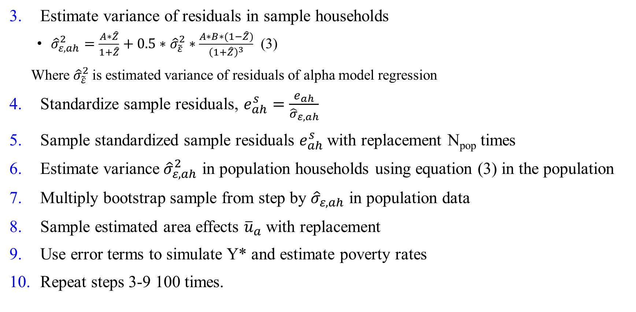
1. What models are we comparing?
ELL estimation process
Estimate variance of residuals in sample households
  ${\hat{σ}}_{ε,ah}^{2}=\frac{A∗\hat{Z}}{1+\hat{Z}}+0.5∗$ ${\hat{σ}}_{\tilde{ε}}^{2}∗\frac{A∗B∗(1−\hat{Z})}{{\left(1+\hat{Z}\right)}^{3}}$ (3)
Where ${\hat{σ}}_{\tilde{ε}}^{2}$is estimated variance of residuals of alpha model regression
Standardize sample residuals, $e_{ah}^{s}=\frac{e_{ah}}{{\hat{σ}}_{ε,ah}}$
Sample standardized sample residuals $e_{ah}^{s}$with replacement N_{pop} times
Estimate variance${ \hat{σ}}_{ε,ah}^{2}$ in population households using equation (3) in the population
Multiply bootstrap sample from step by ${\hat{σ}}_{ε,ah}$ in population data
Sample estimated area effects ${\overline{u}}_{a}$with replacement
Use error terms to simulate Y* and estimate poverty rates
Repeat steps 3-9 100 times.

Slide 6
1. Unit level models: EBP vs. ELL
  How do the results compare?
Mexican census 2010
Correlations
Errors
Data
Drawing betas

Slide 7
2. Unit-level vs. context-level models: ELL
Mexican census 2010
Correlations
Errors
Drawing betas

Slide 8
2. Unit-level vs. context-level models: EBP
Mexican census 2010
Correlations
Errors
Drawing betas

Slide 9
2. Context-level models: EBP vs. ELL
Mexican census 2010
Correlations
Errors

Slide 10
3. Context vs. area-level models: ELL-EBP-FH
Mexican census 2010
Correlations
Errors

Slide 11
3. Context vs. subarea-level models: ELL-EBP-FH
Mexican census 2010
Correlations
Errors

Slide 12
4. Area vs. subarea-level models: FH-BRF
Mexican census 2010
Correlations
Errors

Slide 13
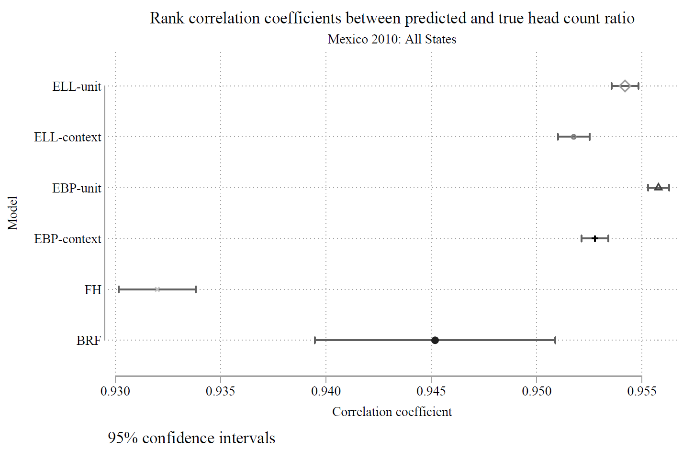
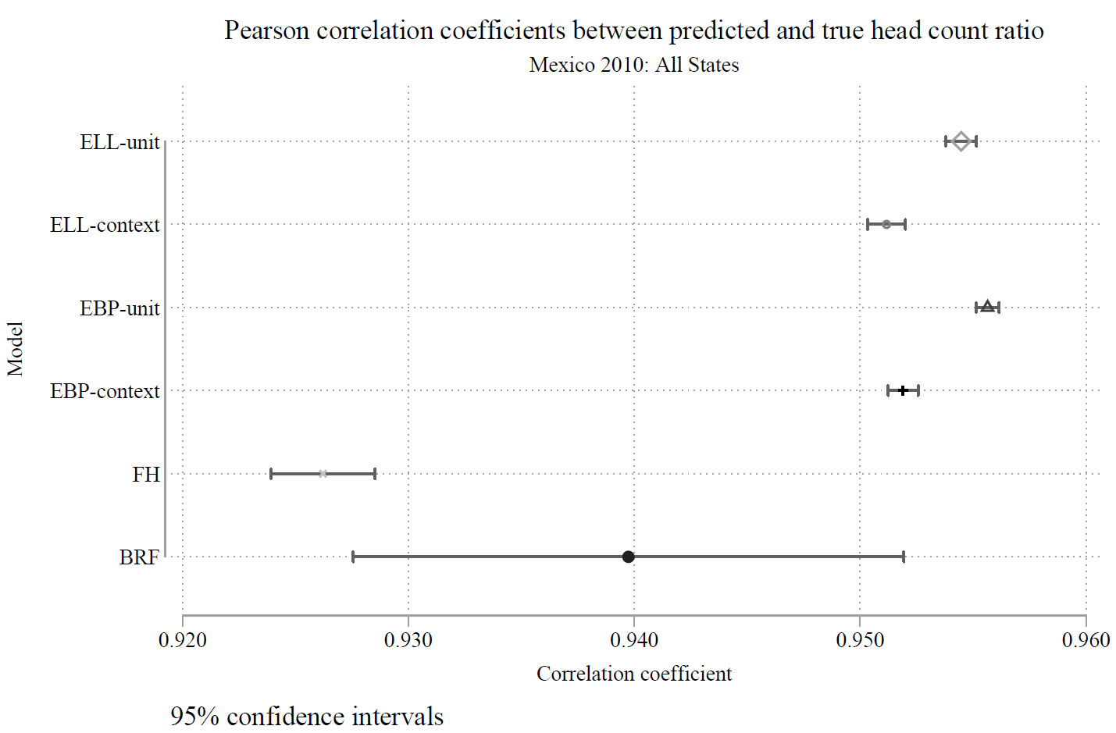
5. Overall comparison across models
Mexican census 2010

Slide 14
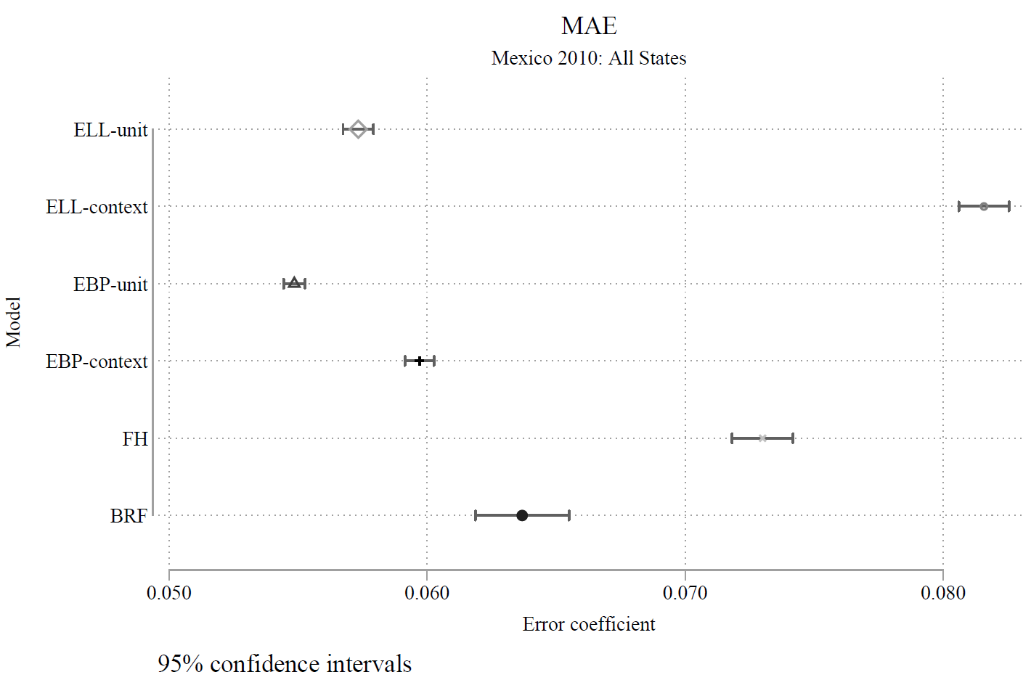
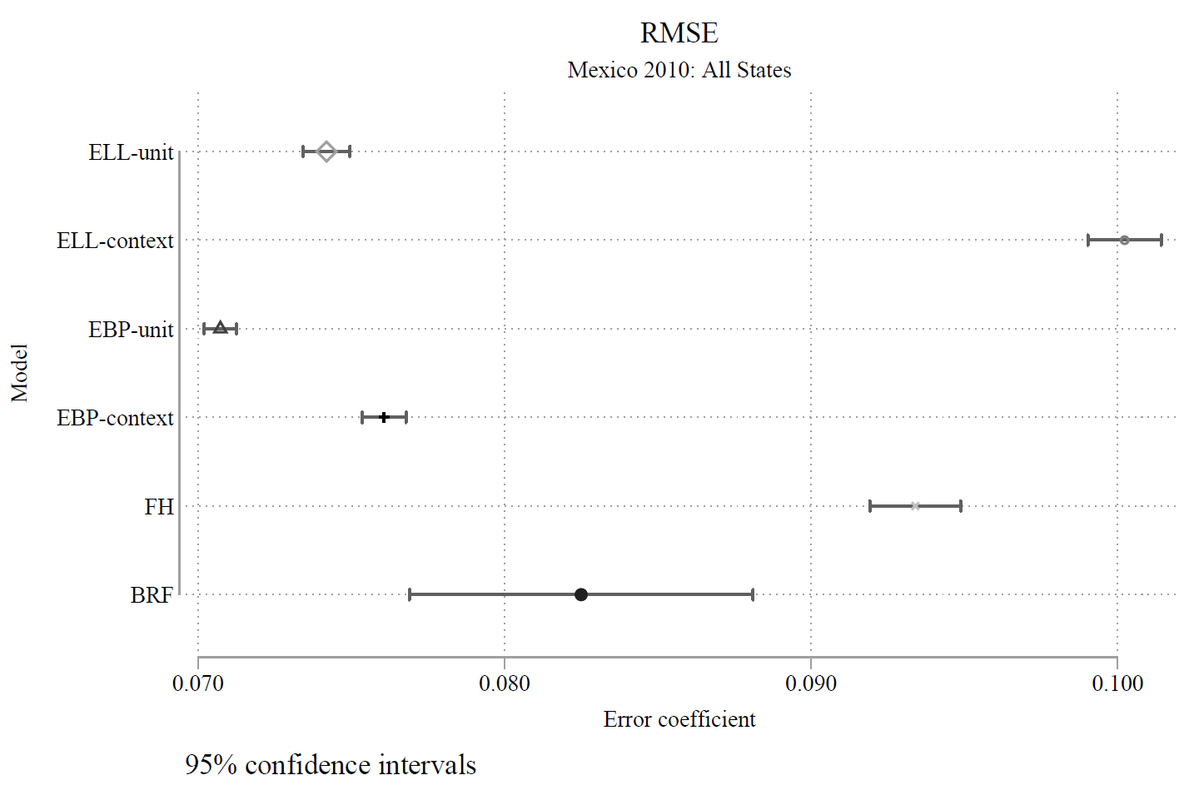
5. Overall comparison across models
Mexican census 2010

Slide 15
5. Overall comparison across models
Mexican census 2010
 | Rank correlation | Pearson correlation | MAE | RMSE
1 | EBP unit | EBP unit | EBP unit | EBP unit
2 | ELL unit | ELL unit | ELL unit | ELL unit
3 | EBP context | EBP context | EBP context | EBP context
4 | ELL context | ELL context | BRF | BRF
5 | BRF | BRF | FH | FH
6 | FH | FH | ELL context | ELL context

Slide 16
Summary of findings
Overall performance:
  All models demonstrate strong performance in predicting poverty, with rank correlations ranging from 0.93 to 0.96.
  EBP unit-level models emerge as the best performers, followed by ELL-unit level models, while area-level models perform the poorest.
Unit-Level Model Comparison:
  Comparing unit-level models, EBP models exhibit higher correlation coefficients and lower errors compared to ELL models.
Context-Level Model Comparison:
  EBP-context level models perform better than ELL-context level models, although differences in rank and Pearson correlation coefficients are not significant.
  Context-level models, both ELL and EBP, perform better than FH (area-level) and BRF (subarea-level) models in terms of correlation coefficients.
Model Granularity Comparison:
  Subarea-level models outperform area-level models.
Model Robustness:
  Drawing the betas for EBP and ELL models does not significantly impact the results.

Slide 17
Next steps
Estimate all models for
  Mexican census 2015 and 2020.
  Brazilian census 2010.
Estimate results for age-bias analysis using the agreed features for all models
  Five-year age bias (Survey 2015-census2010 & survey 2020-census 2015).
  Ten-year age bias (Survey 2020-census2010).
  Five-year survey age bias (Survey 2010-census2015 & survey 2015-census 2020).
  Ten-year survey age bias (Survey 2010-census2020).
Add selection bias to the samples.

Slide 18
Data
Dataset | Census | 100 Simulated samples
Mexican Census 2010 (10% extract) | - Municipalities: 2456 - PSUs: 178 thousands - Households: 2.9 millions | 1. Select pps sample of 900 municipalities 2. Select a sample of 8 PSUs per municipality 3. Select a sample of 5 households in highly urban areas and 20 households in rural and rest of urban areas (~80,000 households)
Mexican Census 2015 (18% extract) | - Municipalities: 2457 - PSUs: 274 thousands - Households: 5.8 millions | 1. Select pps sample of 900 municipalities 2. Select a sample of 8 PSUs per municipality 3. Select a sample of 5 households in highly urban areas and 20 households in rural and rest of urban areas (~106,000 households)
Mexican Census 2020 (10% extract) | - Municipalities: 2469 - PSUs: 252 thousands - Households: 4 millions | 1. Select pps sample of 900 municipalities 2. Select a sample of 8 PSUs per municipality 3. Select a sample of 5 households in highly urban areas and 20 households in rural and rest of urban areas (~75,000 households)
Brazilian Census 2010 (10% extract) | - Municipalities: 5565 - Households: 6.1 millions | 1. Select pps sample of 900 municipalities. 2. Select a random sample of households (~90,000)
Back

Slide 19
1. Unit level models: EBP vs. ELL
  How do the results compare when we draw the betas?
Mexican census 2010
Correlations
Errors
Back

Slide 20
1. Unit level models: EBP vs. ELL
  Results using Stata SAE package
Mexican census 2010
Correlations
Errors
Back

